Slide 1
OSU Ticket Sales Analysis

Slide 2
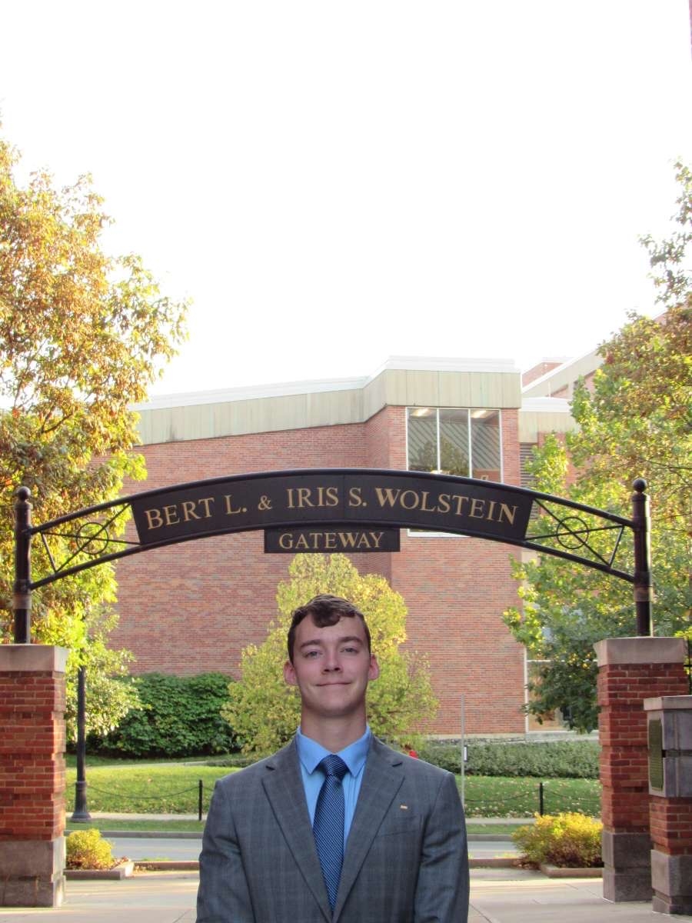



Meet The Team
Nick Perusek
Major: Finance
Minor: Business Analytics
Jack Sayre
Major: Data Analytics
Deep Gupta
Majors: Actuarial Science and Data Analytics
Ryan Kline
Major: Data Analytics

Slide 3
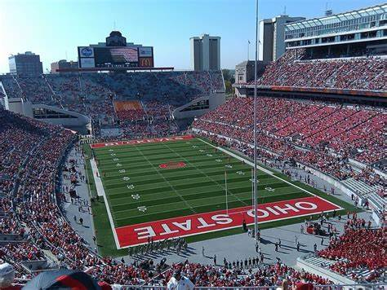
Project Description
Description:
Conducting an in-depth analysis of Ohio State football games with the aim of providing insights into business analytics questions. We are specifically looking at attendees’ gate entry compared to the section their seat is located in.
Data provided by Kate Nushart (nushart.1@osu.edu), Athletic Ticketing Director of the Ohio State Athletics Department

Slide 4
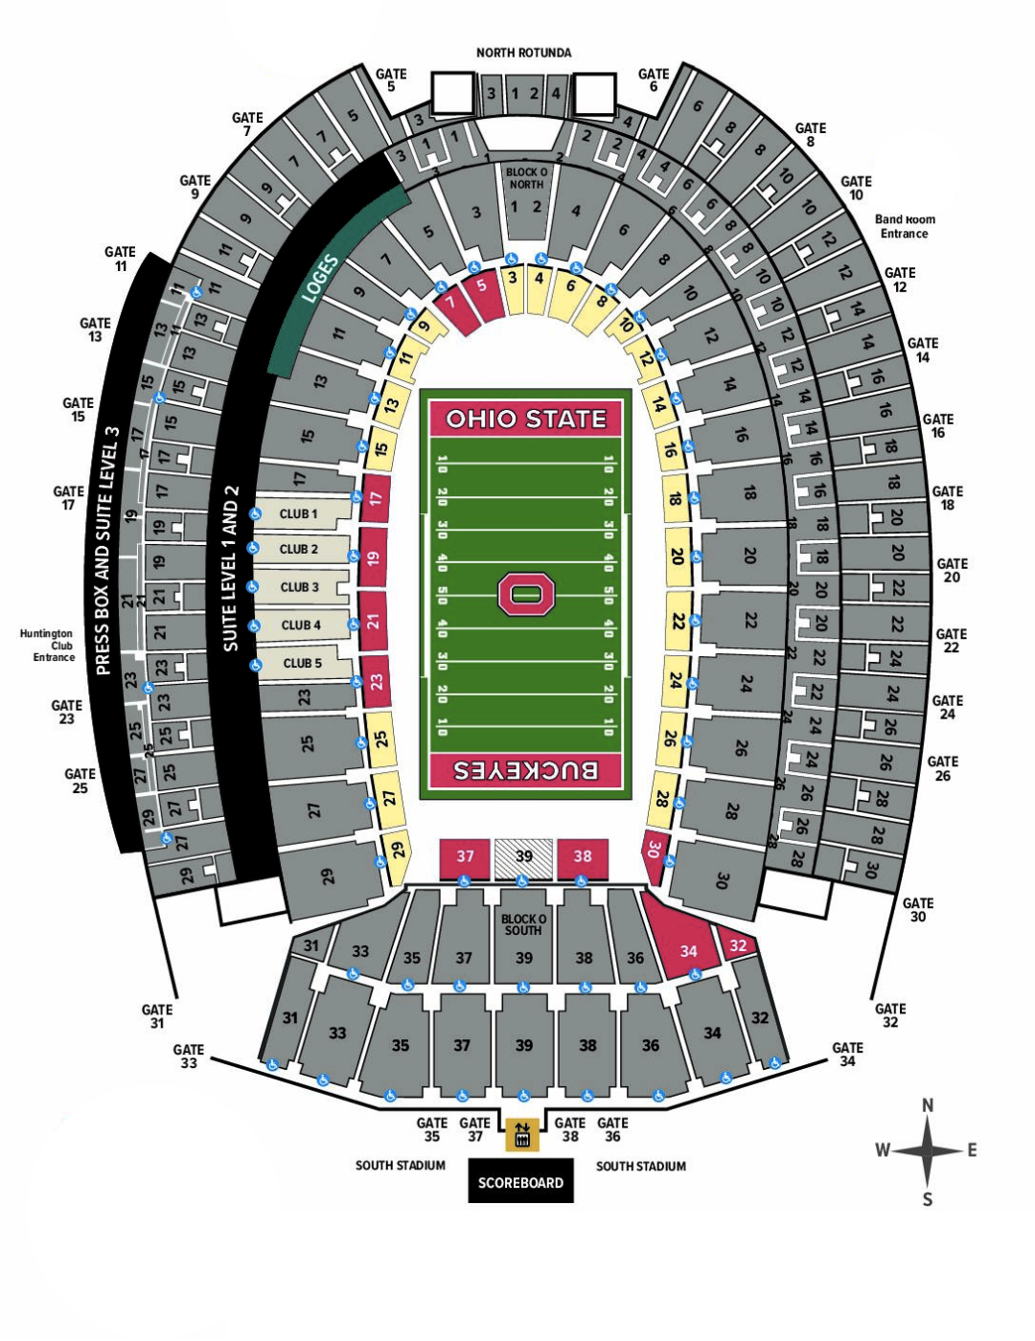
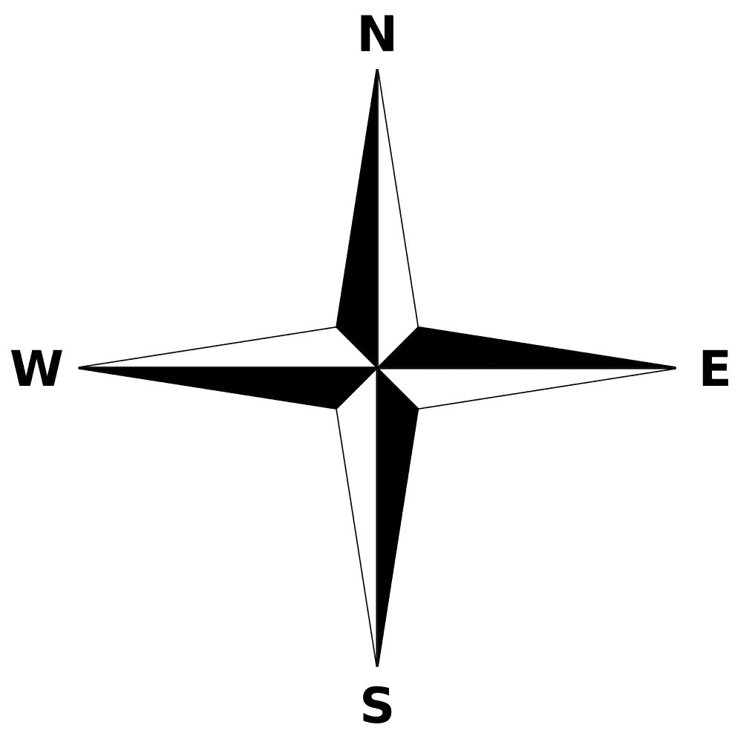
8.37%
Gate Entrance by Percent
14.37%
18.67%
Entire Season
30.73%
5.78%
6.84%
12.81%
33.48%
5.7%
7.03%
10.26%
17.89%
2.79%
*Excludes Club, Press,
Band, and Recruit entrances
15.1%

Slide 5
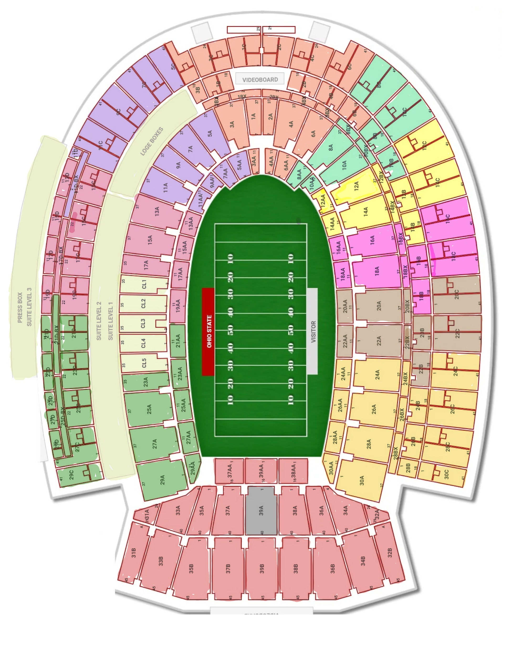
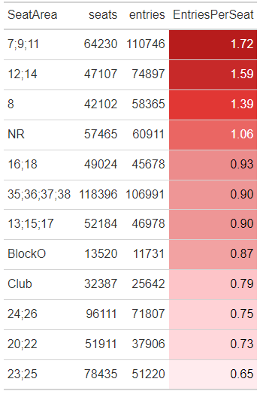
Overcrowded Areas of Stadium
4.
Entire Season
Seats: Number of tickets scanned with section name on ticket
Entries: Number of people scanned through gate
Entries Per Seat: For every one person designated to sit in the section, how many people scanned through gate
1.
3.
1.
2.
3.
4.
2.

Slide 6
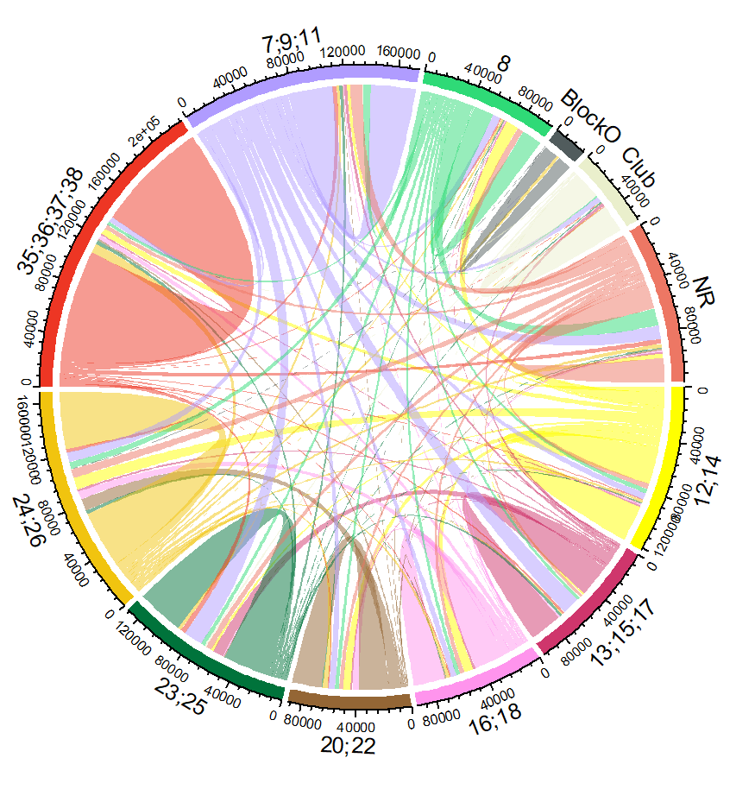
Flow from Gate to Section
NR
Entire Season
7;9;11
8
12;14
13;15;17
16;18
20;22
23;25
24;26
35;36;37;38

Slide 7
Distribution of Section Based on Gate Entered
110,746 Scans
Gate 7, 9, 11
Entire Season
Entries Per Seat: 1.72 | Gate 7, 9, 11
7% of attendees entering through gate 7, 9, or 11 sit in section 24, 26, 28, or 30 which is on the opposite side of the stadium
32.3% of attendees entering through gate 7, 9, or 11 sit in action 5, 7, 9 or 11 which is the most effective way to enter the stadium
One goal for the Ohio State Athletics Department is to get a higher percentage of people to enter through their most effective gate
9.5%
32.3%
5.4%
4.6%
11.2%
4.1%
3.7%
7%
12.3%
2.7%

Slide 8
Distribution of Section Based on Gate Entered
Entire Season
74,897 Scans
Gate 12, 14
Entries Per Seat: 1.59 | Gate 12, 14
2.5% of attendees entering through gate 12 or 14 sit in section 21, 23, 25, or 27 or 29 which is on the opposite side of the stadium
37.2% of attendees entering through gate 12 or 14 sit in section 12 or 14 which is the most effective way to enter the stadium
Comparing gate 12 and 14 to gate 7, 9, and 11 shows entries per seat decreases as the percentage of most effective entry increases
4.5%
13.4%
3.2%
37.2%
2%
9.7%
7.8%
12.7%
2.5%
5.9%

Slide 9
Distribution of Section Based on Gate Entered
Entire Season
Entries Per Seat: 0.65 | Gate 23, 25
Only 1.2% of attendees entering through gate 23 or 25 sit in section 12 or 14 which is on the opposite side of the stadium
64.3% of attendees entering through gate 23 or 25 sit in section 21, 23, 25, 27, or 29 which is the most effective way to enter the stadium
This furthers our claim that entries per seat decreases as the percentage of most effective entry increases
2%
1.4%
4.2%
1.2%
4.5%
1.2%
2.2%
51,220 Scans
Gate 23, 25
5.3%
64.3%
4.8%

Slide 10
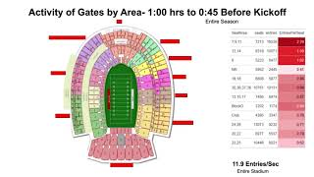
Activity of Gates Over Time
Entire Season
https://youtu.be/dPpHBRMV-Sw
Slides

Slide 11
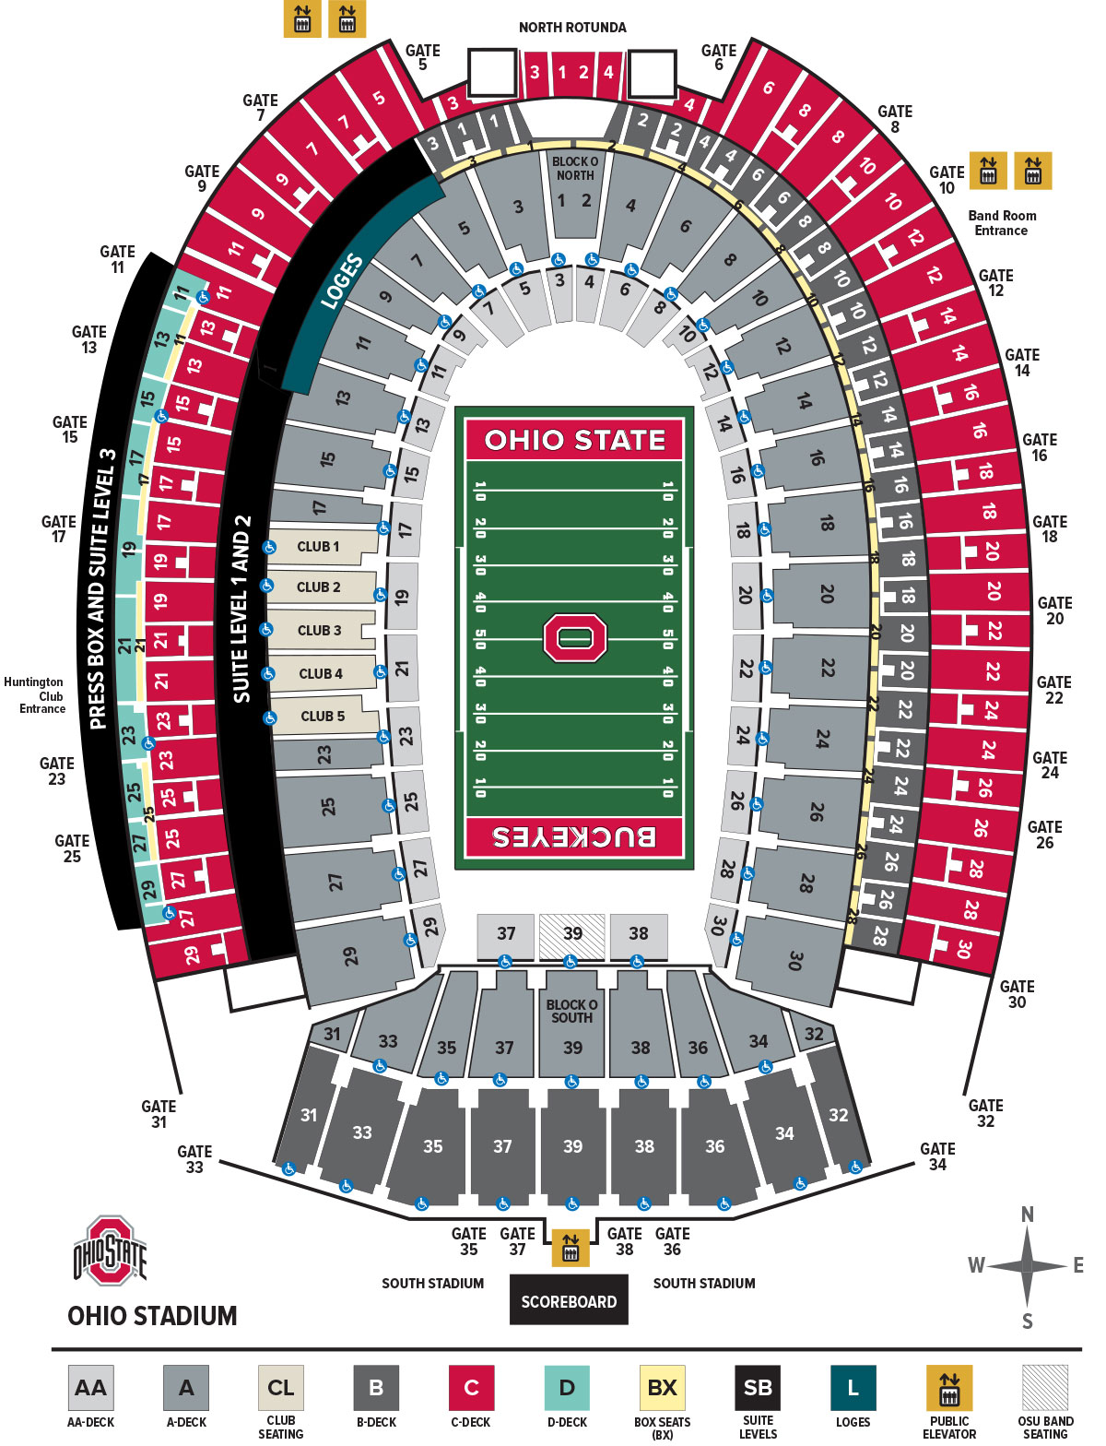
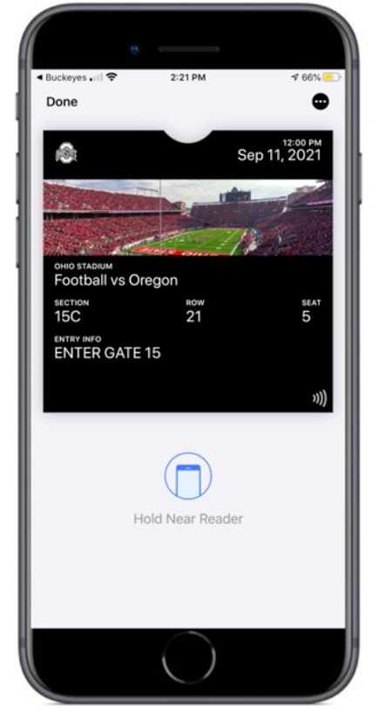
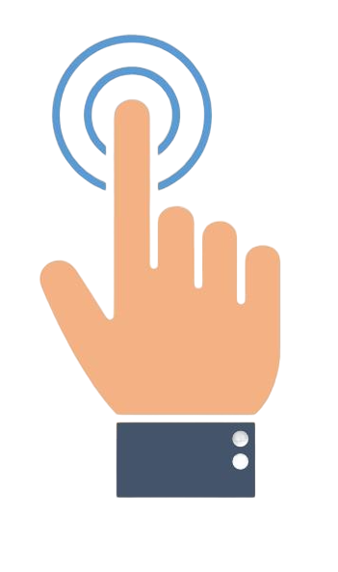
Actions (potential)
GATE
15
ENTER
STADIUM MAP

Slide 12
Actions (potential)
North overcrowding likely result of convenience to tailgates
Proper signage
Add map directing to correct gate entry on tickets
Increase amount of scanners at overcrowded gates
Staff announcing incentives for correct entry
Incentives to consider:
Food/drink voucher for correct gate entry
Section-specific merchandise giveaways

Slide 13
Actions (potential)
Why solve this issue?
More optimal entry → more time in stadium → more in-event revenue
More organized flow of traffic → better fan experience
Safety concerns:
Security gates overcrowding
Measure this with time data from alcohol sales group
If we shift the curve through timing and optimal entry, we estimate additional expected revenue

Slide 14
Next Steps
With data on early arrival transactions, evaluate prior slide question
Will be quick proof of value
Assess - surveys of those who do arrive at certain earlier times
More effort - need staff dedicated to this
Creating a good survey
Triggered notifications post-game
“We noticed you entered in this section…”
Costly initial set up

Slide 15
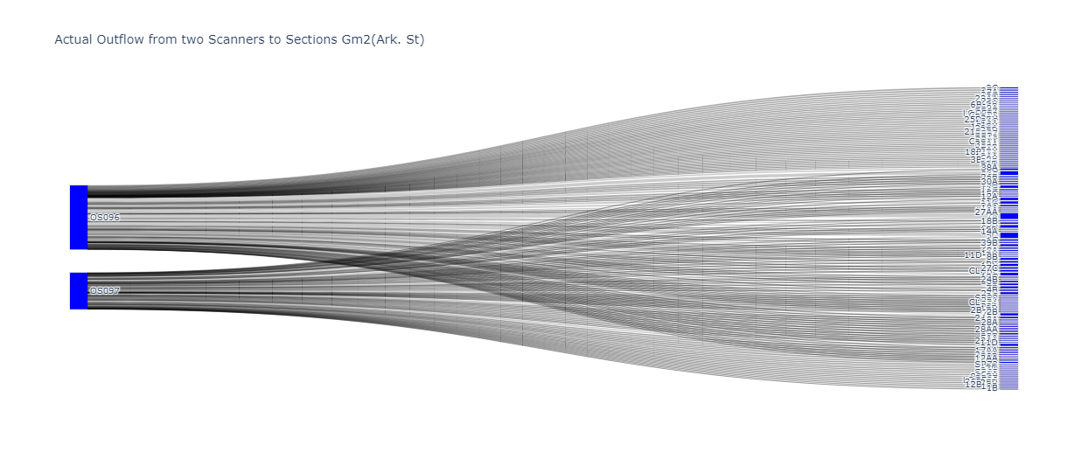
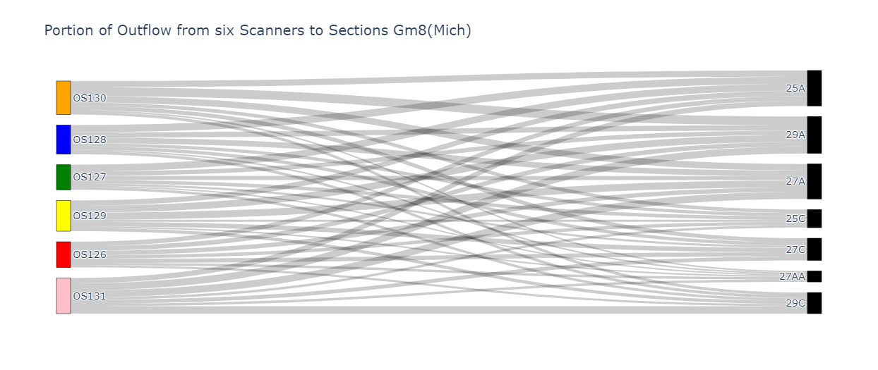
Appendix

Slide 16
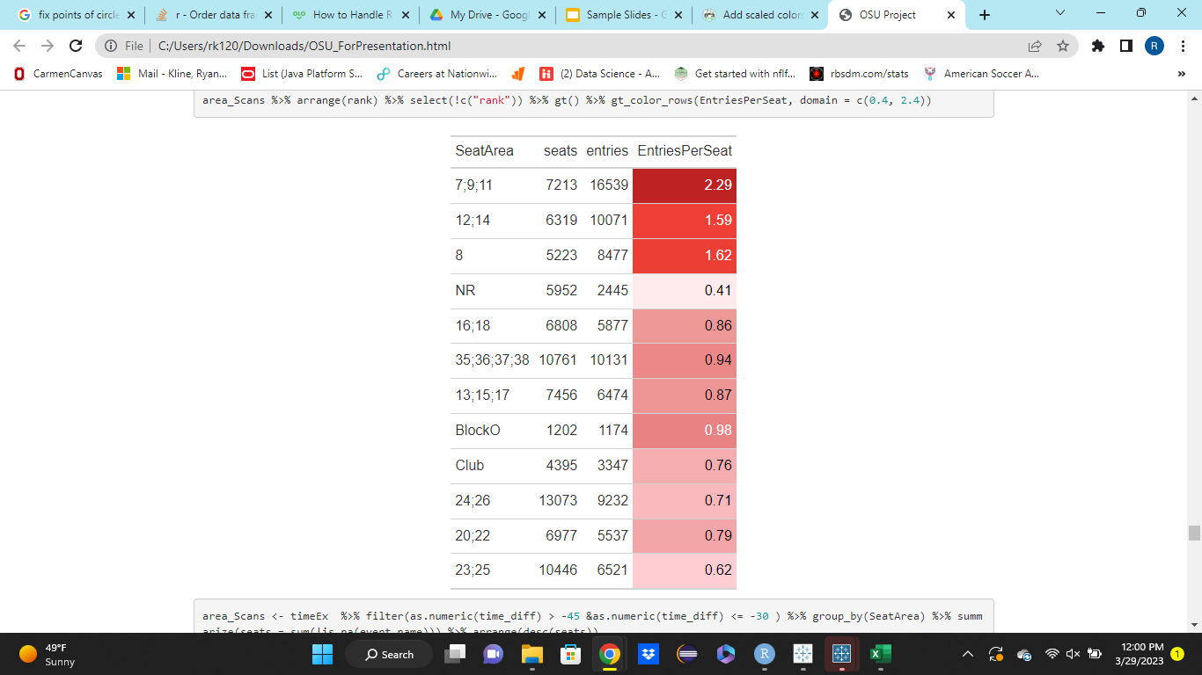
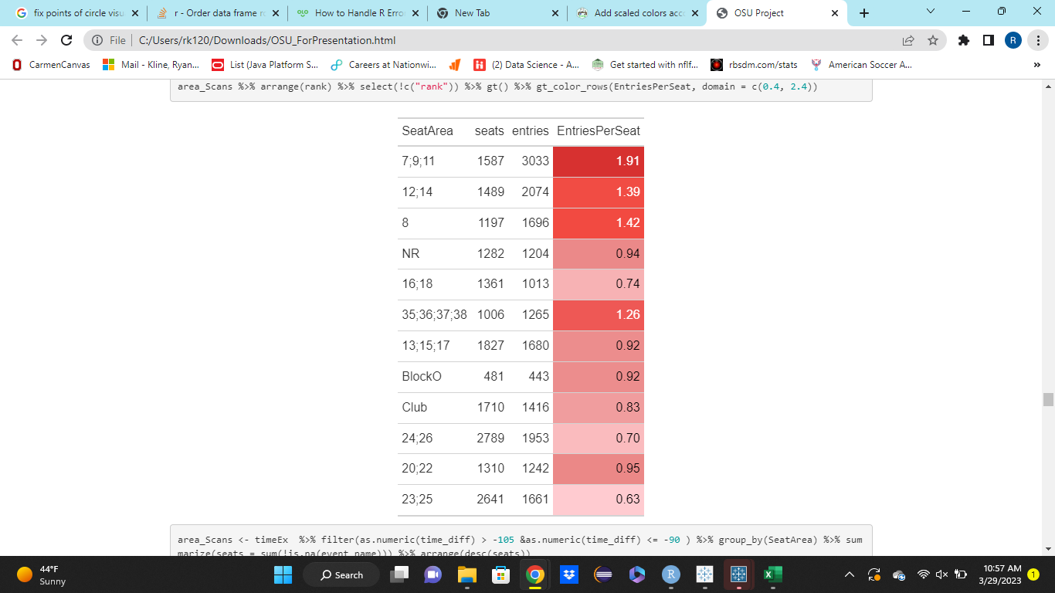
Activity of Gates by Area- 1:00 hrs to 0:45 Before Kickoff
Appendix
Entire Season
11.9 Entries/Sec
Entire Stadium

Slide 17
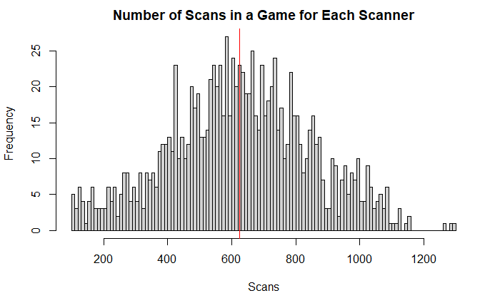
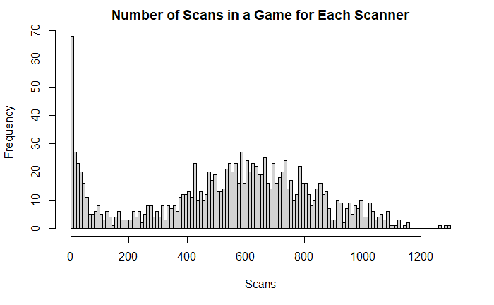
Appendix
Median: 624 Scans

Slide 18








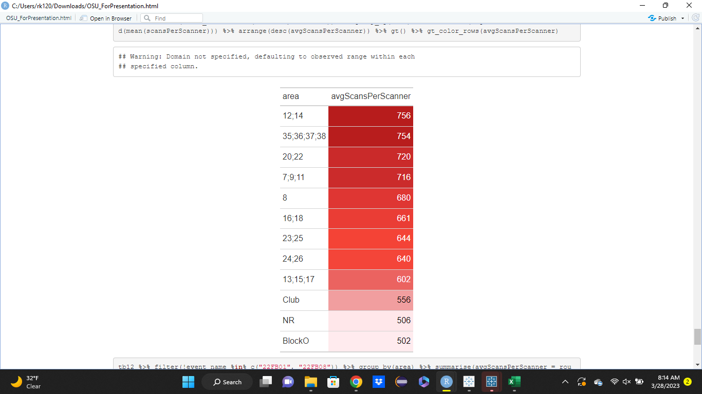
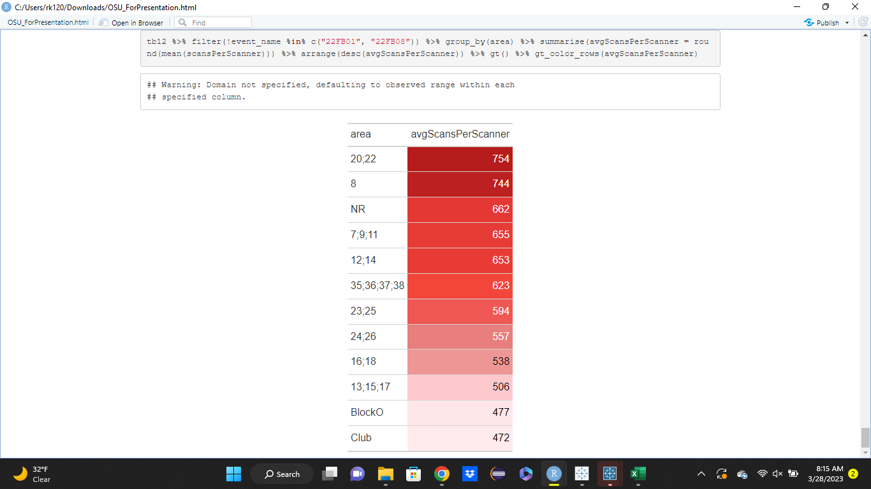
Appendix
Overcrowded Areas of Stadium-Per Scanner

